Slide 1
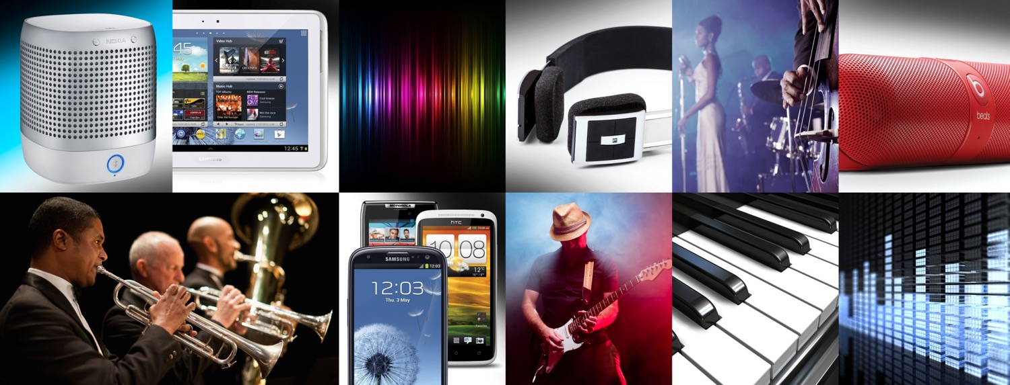

High quality, low latency wireless audio

Slide 2
Revolutionizing the
Bluetooth® listening experience

Slide 3
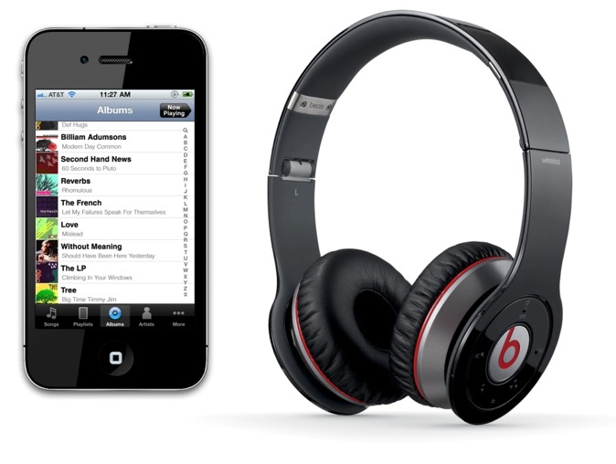

Revolutionizing the
Bluetooth® listening experience
Enjoy high resolution wireless audio
Stream from your aptX-enabled tablet
or smartphone
Lose the wires without compromising audio quality

Slide 4


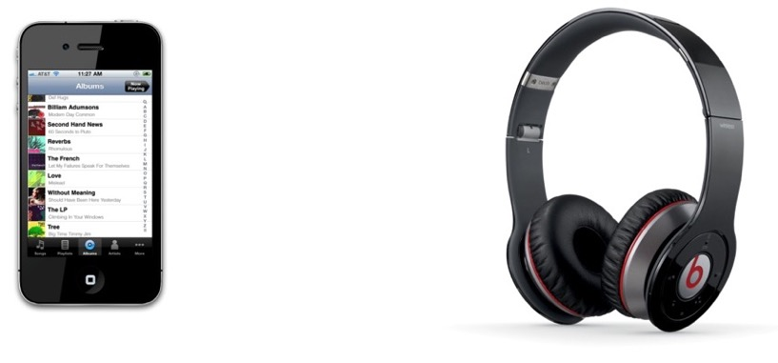

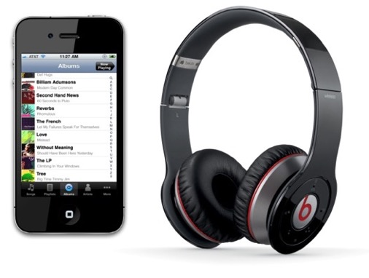



aptX Low Latency
Bluetooth
Bluetooth
with aptX
Low Latency

Slide 5


aptX Low Latency
Delivers high quality
audio over Bluetooth
Low latency ensures audio and video synchronisation for gaming and movies
Revolutionizing the
Bluetooth® listening experience

Slide 6





Just A Few of the Hundreds of Users

Slide 7


The Press says…
“… connecting wirelessly with aptX brings audio quality extremely close to what you would get from a USB socket – which is, to say, brilliant” -- What HiFi Sound and Vision
“The aptX codec in the Galaxy S III finally takes the blurry muddiness out of Bluetooth stereo…” -- PC Magazine

Slide 8


The Press says…
“Bluetooth pairing happens automatically, and the aptX codec support means a minimum of distortion and the clearest possible sound quality.” -- PCworld.com
“If you're out for portable Bluetooth headphones, look for the aptX codec … it offers much better performance
than standard Bluetooth.”
-- TrustedReviews

Slide 9


The Press says…
“How to use your iPod/iPhone dock in the post 30-pin world......The Blue Ant Ribbon aims to bring aptX Bluetooth streaming to your now obsolete 30-pin gear.”
-- Sound & Vision Magazine
“Bluetooth makes a comeback at IFA... one of the reasons Bluetooth is staging a comeback is aptX.”
-- E&T Magazine

Slide 10
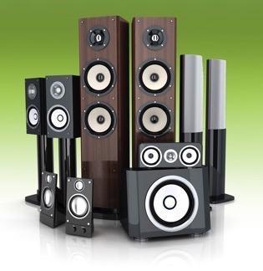

The Press says…
“… brings reliable, multi-room, audiophile-quality wireless streaming to your
home audio system”. -- PC Magazine
“Partner them with an aptX-enabled phone such as the Samsung Galaxy S III or HTC One X and they sound even better – now we're just hoping the
iPhone 5 has aptX built in.” -- Stuff

Slide 11


Slide 12
T H A N K Y O U

